Slide 1
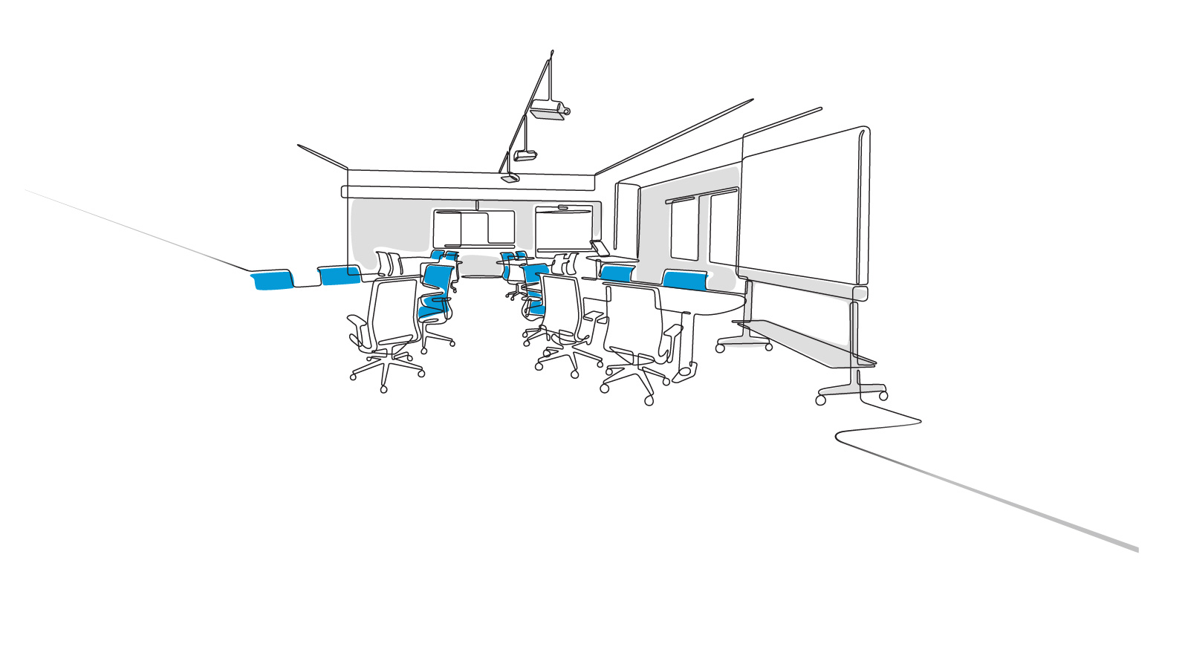

harder working schools
prepared by Steelcase Education Solutions

Slide 2
we’re pleased to share our research with you
Learning environments are changing dramatically due to changing demographics and technology.
To better leverage school real estate, schools are prepping in-between places, from hallways to cafes and lounge spaces, as places where learning can happen. Add wi-fi, comfortable seating, and room to spread out work and almost any space becomes useful work space.
Discussions often migrate from the classroom to the quadrangle, cafeteria, or the nearest Starbucks after class. Now, places outside the classroom are more useful than ever as learning spaces, for two reasons.
First, portable technology means you don’t have to be near a power outlet to work and wi-fi brings online access to the remotest corner of the school.
Second, school work now involves a lot of group projects. More assignments reflect and teach real-world knowledge: collaborating in pairs, small groups, and teams. Since many classrooms poorly support group work, students often decamp to places better suited to working together. Why not make suitable spaces available on campus that extend learning outside the classroom, keep the group together, and the conversation going?
Discover how you can increase the strategic value of your educational environment … as a place to teach, a place to learn, and a place that student, faculty, and staff will enjoy – make it harder working

Slide 3
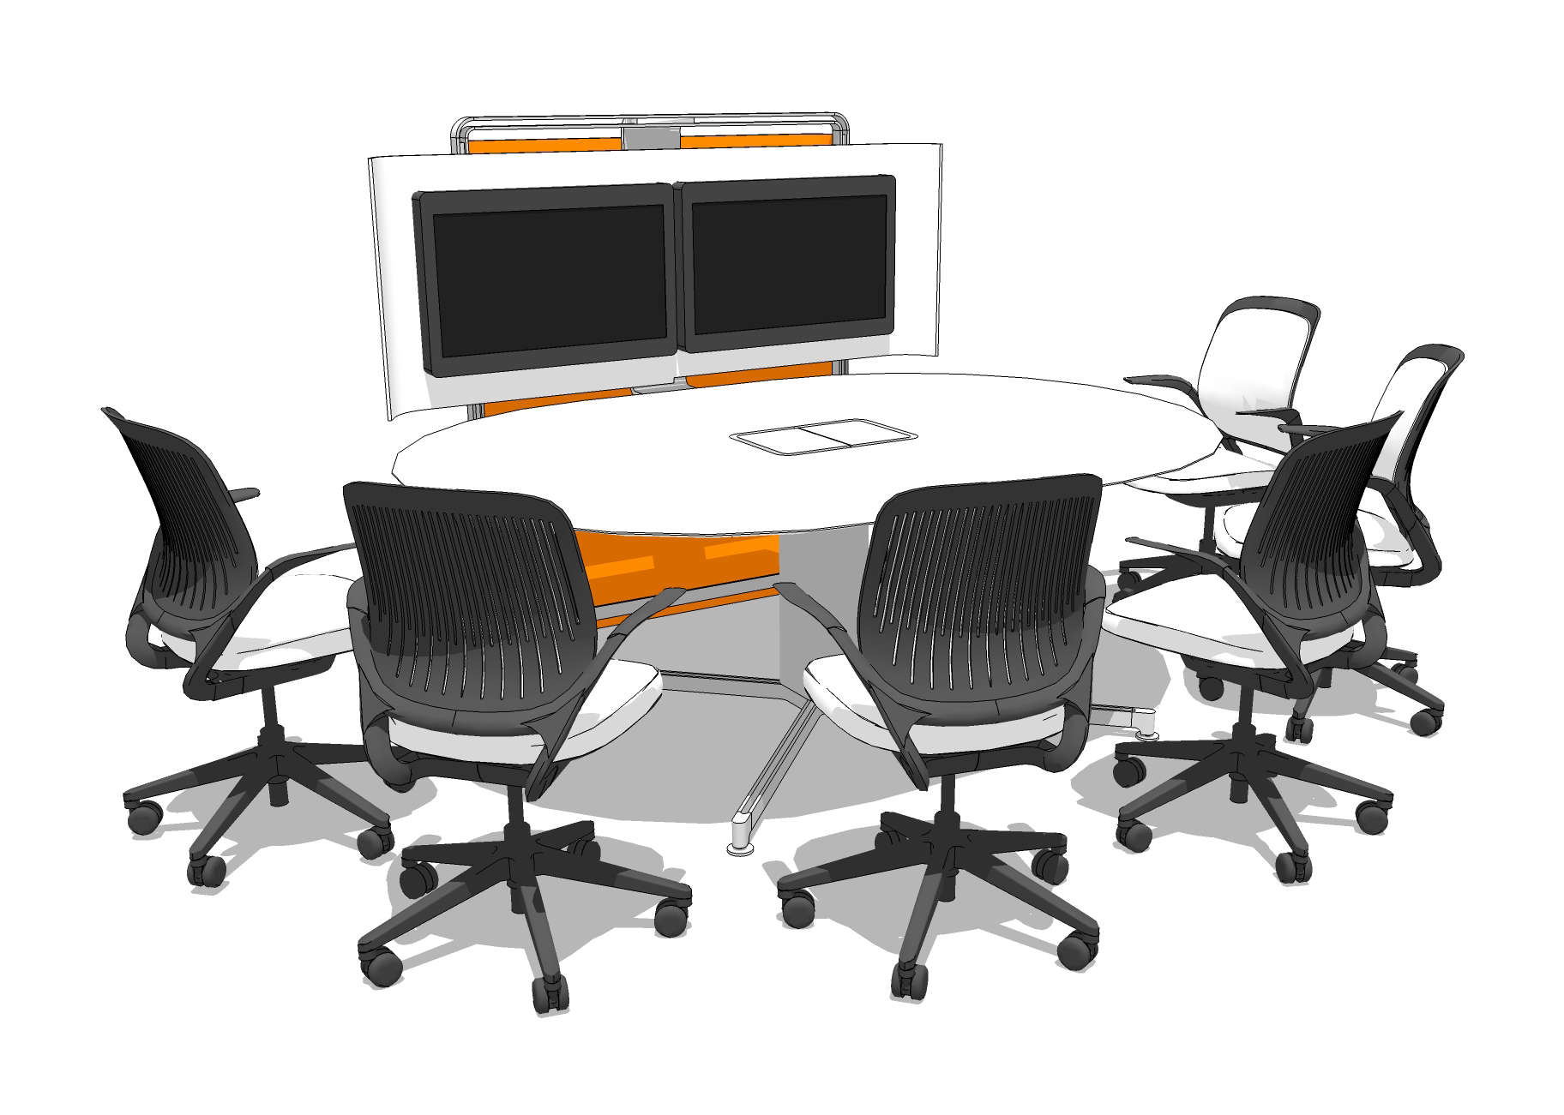
technology space | co-creation
EXAMPLE

Slide 4
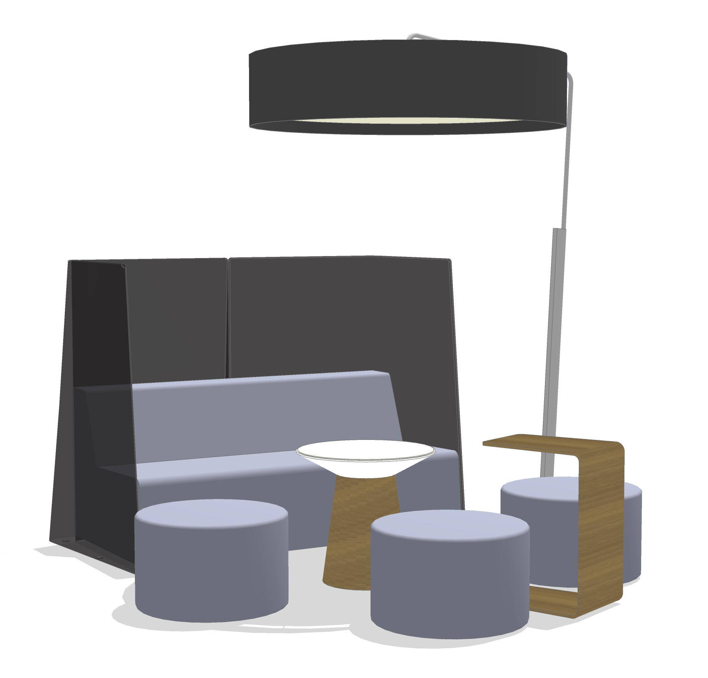
gather ‘round | the campfire
EXAMPLE

Slide 5
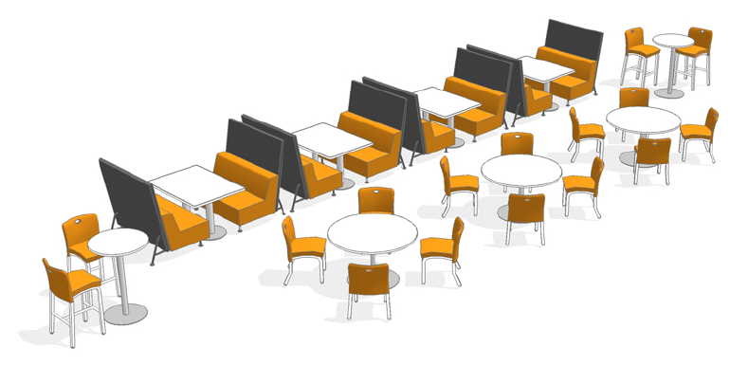
share in a | social area
Primary Work Dynamic
communication
Activities Performed
relax/rest
socialize
eat/drink
meet/encounter
Solve User Needs
communication
stimulate and inspire
connect groups
encourage inter-group learning
User Experience
a great social space that enables learning, communication, and decision making
EXAMPLE

Slide 6
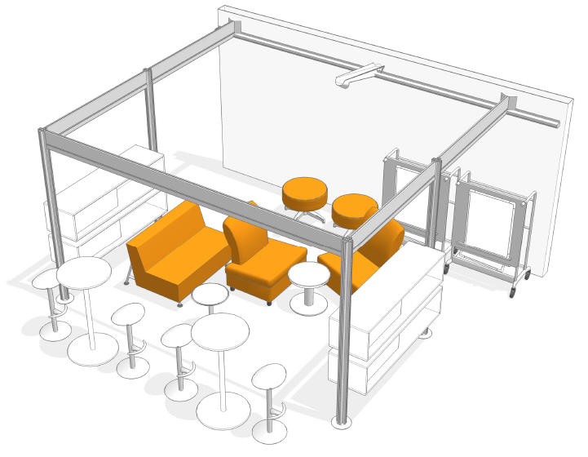
in-between | social space
Primary Work Dynamic
learning
sharing
Activities Performed
gather information
post & display information
meet/encounter
Solve User Needs
communication
support mentoring
encourage inter-group learning
User Experience
mobile tools support learning and sharing as well as display needs
EXAMPLE

Slide 7
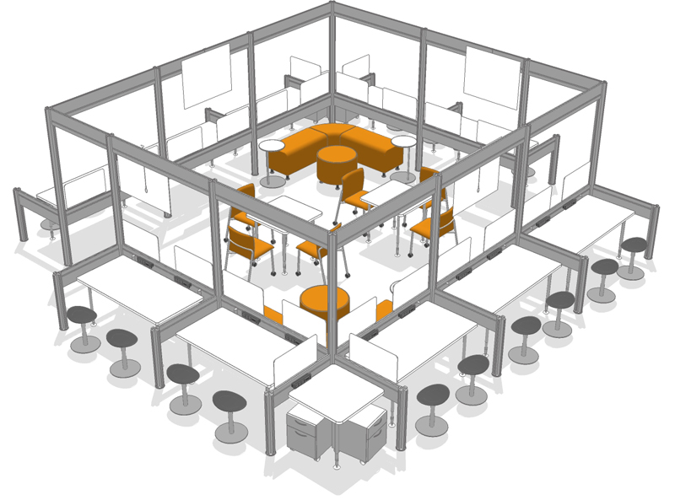
touch down | individual & shared spaces
Primary Work Dynamic
learning
sharing
Activities Performed
socialize
eat & drink
gather information
meet/encounter
exchange feedback
transfer knowledge
Solve User Needs
communication
support mentoring
encourage inter-group learning
EXAMPLE

Slide 8
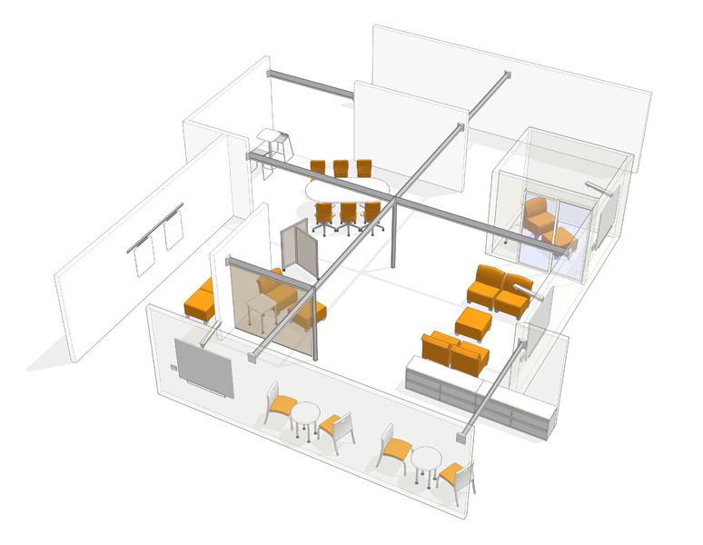
community | “courtyard” space
Primary Work Dynamic
learning
sharing
mentoring
Activities Performed
rest/relax
socialize
eat & drink
gather information
post & display information
meet/encounter
exchange feedback
transfer knowledge
post/display information
Solve User Needs
communication
support mentoring
encourage inter-group learning
increase effectiveness of informal interaction
User Experience
mobile tools support learning and sharing as well as display needs
EXAMPLE

Slide 9
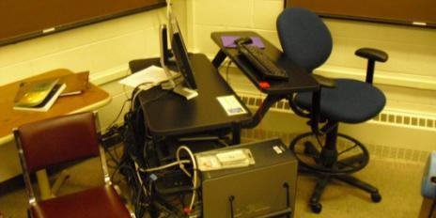
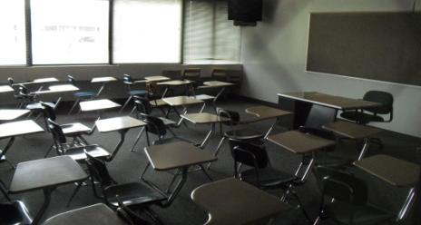
drivers for change in the classroom
Most classrooms are a barrier to learning and don’t support the individual needs of students and instructors. There are several drivers for change in classrooms today:
demand for 21st century work skills
adoption of new pedagogies
emerging technologies
implication of gen Y and Millennial
increased accountability for student success
trends & insights
Research insights
most classrooms are a barrier to learning
new tools are being applied in traditional ways
peer to peer learning and instructor guidance are the new norms
classrooms do not support the individual needs of students and instructors
classrooms have their own rhythm and pace
learning happens everywhere

Slide 10
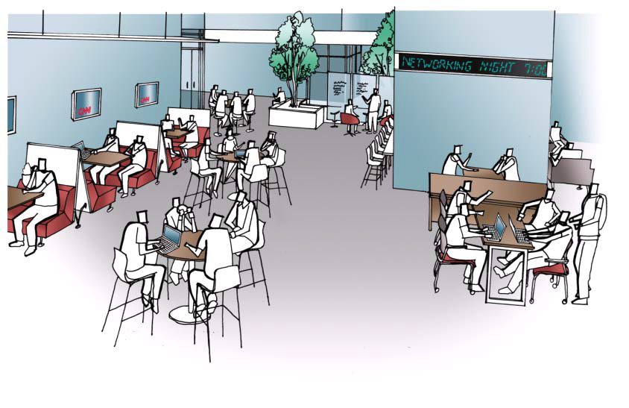
trends and insights in education
Today, amidst all the changes in education, both educators and designers of learning spaces are rethinking the classroom, looking for a comprehensive space that incorporates user-friendly technology, flexible furniture, and other new tools that support active learning. Libraries are changing, too, evolving from the book warehouses to places for group and individual learning. All over campus, hallways, commons areas, cafes, and other in-between spaces are extending the learning experience. Every space in today’s schools is a learning space.
The question then becomes, “amidst all the change and challenges, how can today’s campus best be utilized?” Here you’ll find thought starters for learning spaces in your school.
Steelcase researchers have studied education for more than a decade and have developed a deep understanding of learning spaces and the needs of students, faculty, and administrators. To gain an inside look at learning environments, the Steelcase WorkSpace Futures team studied a dozen different universities across the U.S., including public, private, and community colleges.

Slide 11
human-centered design process
Steelcase Education Solution’s research in learning, working and collaborating.
secondary research
conversant with language
trend analysis
photography, ethnography
contextual interviews
participatory design
insights recognized
develop design principles
create thought starters
develop new solutions
understand
observe
synthesize
realize
prototype
measure

Slide 12
evolving educational environments
Reaching an understanding: our first research step is to understand the issues facing education today. What are they? Are they changing? If so, how?
Observing what actually goes on. How do these issues play themselves out in instructional spaces, in-between, and faculty offices? What are we discovered is that nearly all of the learning environments observed – while capable of supporting one learning mode – are simply too inflexible to support, facilitate, or enable the diverse learning activities that go on in today’s educational environments.
Synthesizing the data. The purpose of any research project is to gain new knowledge, develop a point of view, and arrive at a conclusion. The goal is to turn what we learn into innovative product solutions and create more effective learning environments. Our research led us to design ideas that have the potential to dramatically change the way educational facilities look, feel, and act.
Arriving at a result. The result is a set of spaces that can help an institution differentiate itself…as a place where the best and brightest faculty, students, and staff want to come and stay. These spaces suggest a number of different ways that instructional spaces, offices, and informal places can be included and developed as learning spaces. Spaces that engage all constituents in a full and enriching range of activities … before, during, and after a class.

Slide 13
what we’ve learned
Today’s schools must teach 21st century skill sets:
collaboration
teamwork
creative problem solving
critical thinking
Learning preferences are recognized and teaching methods using problem-based methods are being employed with regularity.
Rapid changes in technology to allow for constant technology maintenance and upgrades.
Students are digital natives demanding more integration within learning and working environments.
Employers want students with 21st century skill sets.

Slide 14
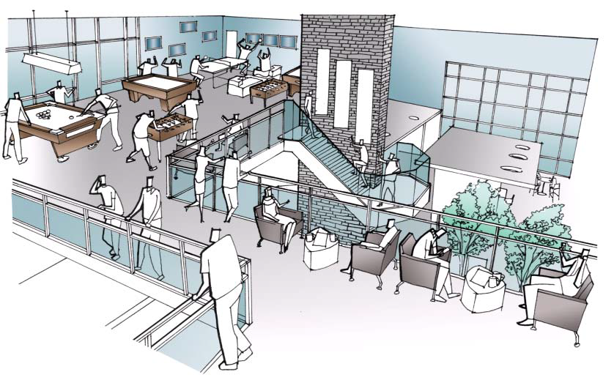
some facts about sustainability, Steelcase, and the dealer

Slide 15
sustainability – designing for the environment
It begins with a passion for doing what’s right. A long-term commitment to human and environmental health.
Materials Chemistry
You can’t eliminate what you don’t know exists. Materials Chemistry helps us target chemicals of concern so they can be reduced or eliminated. Our entire product portfolio is undergoing this analysis (not just our new products, but our existing ones too).
Lifecycle Assessment
An LCA measures the environmental impact of processes (extraction, production, transport, use, disposal). By understanding where and how a product is made, you can identify optimization opportunities relating to energy and materials.
Recycling & Reuse
Our products are designed for easy disassembly, recycling and reuse.
As a result of this approach Steelcase has more Cradle to Cradle^{CM} Certified products than anyone in any industry.

Slide 16

sustainability – people, planet, profit
We’re all in this together. Business is a human experience that’s fundamentally about providing solutions and doing right by people. For a long time, that’s been our touchstone at Steelcase—a standard that’s defined us and guided us.
Our legacy reaches back now almost 100 years to 1912 when our company began. The business world has become more complex, yet we rediscover every day that the simple truth of our touchstone remains solid and true.
People, planet and profit. Connected together in a global economy, they’re the spectrum of sustainability—for Steelcase as a business, for the many communities we call home, and for the world that belongs to all of us.
Like all global companies we are accountable to our employees and stakeholders to run a profitable, responsible business; but we believe a company should also be measured by how well it maximizes the value of its efforts by finding the right balance between profitability, environmental sustainability and social responsibility .
At Steelcase optimizing the combination of these three elements has become a source of inspiration for us —leading to smarter products, effective processes and new solutions. We believe designing for sustainability in every aspect of our business is important. It’s part of the essential fabric of who we are.

Slide 17
Steelcase … we have a passion for understanding how learning takes place
“You send your child to the schoolmaster,
but ’tis the schoolboys who educate him.”
Emerson’s observation is more true than ever. Students are more engaged in learning together, frequently working in groups and interacting with peers.
The professor’s role is changing from “sage on the stage” to “guide on the side,” as educators phrase it. Yet most classrooms are set up for Emerson’s era. That’s why designers and educators are rethinking the classroom, installing flexible furnishings, user-friendly technology, and other new tools that support interactive learning.
Libraries are changing, too, evolving from musty book warehouses to places for group and individual learning. All over campus, hallways, commons areas, cafes and other in-between spaces are extending the learning experience.
Steelcase Facts
110,000+
companies served in the last five years
$2.3 billion
annual revenue (fy2010
1912
company established
20+
manufacturing locations
850
dealer locations
1,400+
patents worldwide
11,000
employees worldwide
#1
global market position since 1974

Slide 18

thank you.

Slide 19
www.steelcase.com

