Slide 1
This resource sponsored by Clarity Innovations
Adaptive Learning Systems

Slide 2
Objectives
Define Adaptive Learning Systems
Examine Levels of Adaptivity and Personalization
Explore Examples of Adaptive Learning Systems
Explore What’s Next in Adaptive Learning Systems

Slide 3
Adaptive Learning – a Definition
The US Department of Education Office of Educational Technology defines adaptive learning systems as follows:
“Digital learning systems are considered adaptive when they can dynamically change to better suit the learning in response to information collected during the course of learning rather than on the basis of preexisting information such as a learner’s gender, age, or achievement test score. Adaptive learning systems use information gained as the learner works with them to vary such features as the way a concept is represented, its difficulty, the sequencing of problems or tasks, and the nature of hints and feedback provided.”

Slide 4
Adaptive Learning – a Definition
Providing just-in-time support
Content decisions
Data
Adaptive learning systems can use this data to automate tasks traditionally reserved for teachers
More technology use in the classroom = more data captured about student activity throughout the learning process
This same data can also be used by students, teachers, administrators and parents to create learning goals
Notes:
As technology use increases in the classroom, more data is captured about student activities throughout the learning process. This information can be used to create individualized learning pathways for students. Systems that attempt to automate this process are called adaptive learning systems and have the potential to drastically change how we educate students.
Adaptive learning systems automate tasks traditionally reserved for teachers, from choosing content to providing just-in-time support. These systems are gradually transitioning from linear, rules-based systems to more complex, algorithm-based systems able to base decisions on more and more data events.

Slide 5
Practices vs. Products
Personalized Learning describes Practices | Adaptive Learning describes Products
Less class time taken up by announcements and lectures/ More class time used for conversation | Students can use software and online services outside of class to interact with content traditionally covered in lectures
Less work assigned for students to complete outside of class/More observation of work done by students during class time | Dashboards and reports generated by products give teachers a view into class-wide trends and individual progress made by students
One-on-one tutoring/coaching provided to all students, either by a human instructor or by software | These products function partly as tutors by providing Interactive feedback and recommended learning paths
Notes:
Adaptive Learning systems are not meant to replace the teacher. Rather, they can be used to support the classroom teacher.

Slide 6
Core Components of an Adaptive Learning System
Content Model:
Adaptive learning systems need substantial content tied to standards and learning objectives to use with learners.
Learner Model:
Adaptive learning systems need to gather info about the learners themselves from simple (what students know) to complex (how students best learn).
Instructional Model:
Adaptive learning systems need to make decisions about next instructional steps, and get the right content to the right learner at the right time.
Notes:
An adaptive learning system involves at least three components:
A model of the structure of the content to be learned (the Content Model)
A means of understanding student abilities (the Learner Model)
A way to present content to the learner in a personalized and dynamic fashion (the Instructional Model)

Slide 7
Levels of Adaptivity and Personalization
Basic
Pre-tests and post-tests assess understanding
Moderate
Provides feedback through hints, additional resources, and questions
Advanced
Analyzes more involved response types to correct students at point of misconception
Content is the same for all students, but appropriate content is assigned to individuals at the right time
Rule-based forking attempts to get the right content to the right student
Dashboard displays multiple data events
Algorithm-based system interprets multiple data points
Improves over time with additional data by generating user profile
Notes:
Adaptivity is a buzzword with a wide variation in meanings. While it is true that more adaptive learning programs can better adapt to the specific needs of individual students, levels of adaptivity are not indelibly linked to levels of personalization.

Slide 8
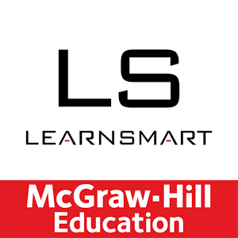
Examples of Adaptive Learning Systems
Crafts personalized paths for students and revisits concepts to help with retention
Triumph Learning’s “personalized practice tool” for math and English/Language Arts
Creates learning pathways for students from a content library and open education resources
Notes:
LearnSmart
LearnSmart helps craft personalized paths for students as they move through textbooks by asking students to answer questions, then mark their level of confidence in the answers. In this way, it determines which concepts have not been fully understood and adjusts content accordingly. LearnSmart also attempts to help with retention by revisiting concepts.
Waggle
Waggle is marketed as a “personalized practice tool” that goes along with Triumph Learning’s all-inclusive math and English/Language Arts curriculum in grades 2-8. The program assesses what students get wrong, how and why they get it wrong, how much help they need, and how they fared in previous attempts to make sure students are learning at the point of struggle.
Brightspace Adaptive Learning Solutions
When D2L (previously known as Desire 2 Learn) acquired Knowillage in September 2013, the company added an adaptive learning platform to their list of services. Knowillage’s product, Learning Path (LeaP), now plays a central role in Brightspace and promises to personalize learning for individual students. Under D2L’s direction, LeaP incorporates standards alignment through the Achievement Standards Network, also recently acquired by D2L. Teachers select learning objects, then LeaP scours the content library as well as open education resources to create learning pathways for individual students that are modified and updated based on student performance.

Slide 9
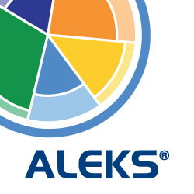
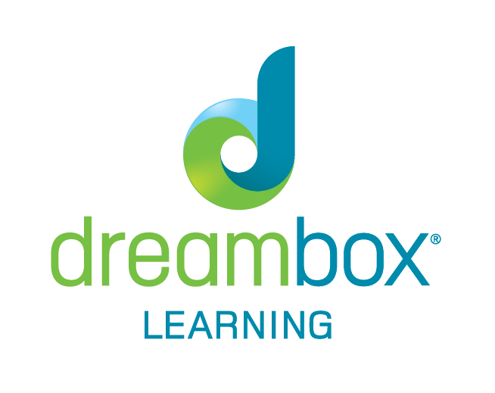
Examples of Adaptive Learning Systems
One of the first Internet-based tutoring programs
Adaptive learning program targeting K-8 math concepts and skills
Notes:
ALEKS
Assessment and Learning Knowledge Spaces (ALEKS) was one of the first Internet-based tutoring programs. ALEKS uses a small number of questions to determine a student’s knowledge and ability level in math and science. Instead of using multiple choice questions, ALEKS asks students to fill in numeric fields, better equipping it to accurately identify points of misunderstanding.
Dreambox Learning
Dreambox Learning is an adaptive learning program targeting K-8 math concepts and skills. Designed to be a supplemental instructional resource, Dreambox’s platform is meant to adapt to individual learners, providing both enrichment and remediation. Its patented Intelligent Adaptive Learning technology collects more than 50,000 data points every hour that a student uses it. Dreambox uses this data to adjust the lesson and level of difficulty, as well as scaffolding, sequencing, number of hints, and pacing. The system also promotes personalization of learning paths by giving students choices about what type of learning activity they engage in.

Slide 10
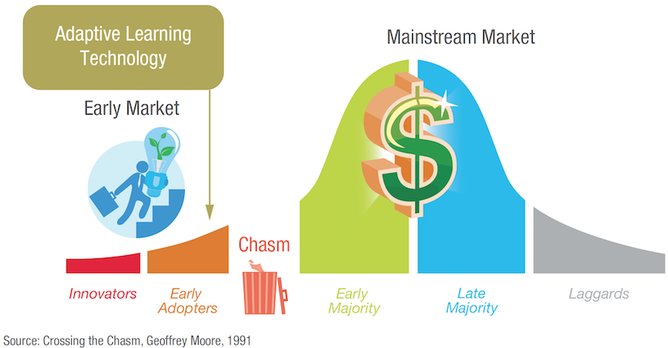
Adaptive Learning – Still in its Infancy
Three pieces of evidence in the coming years will indicate that adaptive learning is transitioning more into the mainstream market:
Additional companies touting adaptive learning solutions
Additional adaptive learning programs and products appearing in the market
Additional evidence, both anecdotal and research-based, highlighting student success with adaptive learning
Notes:
Adaptive learning systems are still in their infancy. Building on the success of a handful of innovators, a number of adaptive learning systems are starting to be used in K-12 institutions around the globe. Much like LMSs in the K-12 market, however exciting the prospects of using an adaptive learning system to personalize learning may be, it is not yet viewed as essential.
In a 2013 report, Eduventures placed adaptive learning on Geoff Moore’s Crossing the Chasm graphic. The Chasm has not yet been crossed.

Slide 11
What’s Next in Adaptive Learning Systems?
Teaching more than math
Moving from supplemental to core
Being actually adaptive
Gather/interpret new data sources
Drawing more meaningful conclusions from data
Notes:
Although adaptive learning systems have seen tremendous growth in the past few years, important challenges still remain:
Teaching more than math: At this point, most adaptive learning systems only target math instruction or other concrete topics. It is much more challenging to create systems for language-dependent learning like writing and reading, where there is no right or wrong answer.
Moving from supplemental to core: Adaptive learning systems are still largely meant to be supplemental learning resources. Teachers may use them occasionally for independent study, but so far at least, they are not viewed as core instructional tools. As a result, it’s easy to view them as non-essential.
Being actually adaptive: Many of these companies say their products are adaptive, but beyond providing some basic interactivity and monitoring student progress through their content, most do not approach the level of actually being an intelligent tutoring system capable of replacing in-person tutoring.
Gather/interpret new data sources: In the coming years, adaptive learning systems will also likely be able to gather and interpret new data sources, increasing systems’ validity across subject areas. For example, AutoTutor, developed at the University of Memphis, uses a conversational system to interact with students and is able to understand student-written responses and question.
Utilizing new hardware and software, adaptive learning systems will also start to gather “affective” data from students, seeking to interpret students’ emotional response to the learning activities. One possible example of this includes using device cameras to gauge understanding and emotions through facial expressions. Wearables may also record data from learners as they work through lessons and assessments.
Drawing more meaningful conclusions from data: many adaptive learning systems are improving their ability to draw meaningful conclusions from the data that they gather. As these systems aggregate more and more students, they will be able to make more insights about students, such as levels of engagement and frustration.

