Slide 1
This resource sponsored by Clarity Innovations
Technology Policy for Administrators

Slide 2
Does your technology policy need an update?

Slide 3
Streamline technology policies
Focus on educational and institutional goals.
Target desired student and staff behaviors rather than specific types of technology.
Refrain from addressing issues covered in other policies.
Source: California School Boards Association. (2012). A New Approach to Technology Policies

Slide 4
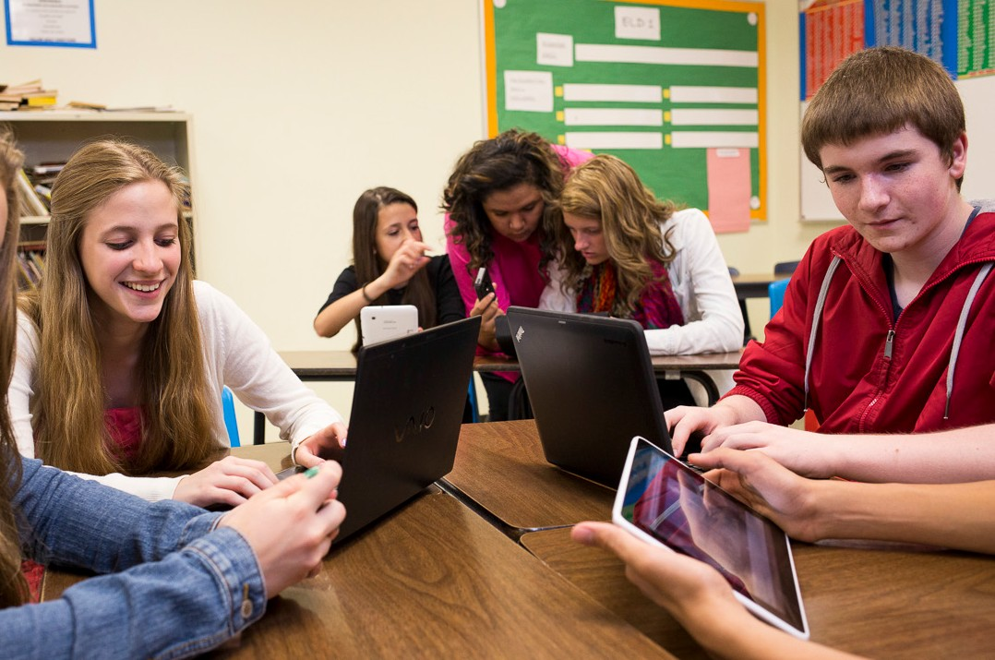
Build policies for instructional technology approaches
Classroom computers
Computer labs
1:1 computing
Bring Your Own Device (BYOD)
Source: California School Boards Association. (2012). A New Approach to Technology Policies

Slide 5
Set technology priorities
Emphasize professional development.
Provide equal access for all students.
Ensure that infrastructure will meet present needs and can grow as necessary.
Communicate with parents
Comply with state and federal regulations, such as CIPA.
Conduct a technology security audit to identify vulnerabilities.

Slide 6
Revisit Acceptable Use Policy
“Highly restrictive Internet and mobile policies in the school environment provide only a false sense of protecting kids.“
Recognize that mobile devices and social media are not only prevalent but have the potential to engage students.
Remember that behaviors such as cyberbullying, copyright infringement, and plagiarism, are addressed in other policies and need not be addressed in AUPs.
Teach students skills for safe and appropriate technology use inside and outside the school environment.
Source: California School Boards Association. (2012). A New Approach to Technology Policies

Slide 7
References and Resources
Brush Up Your AUP. Technology and Learning.
Moving From ‘Acceptable’ to ‘Responsible’ Use in a Web 2.0 World Education Week.
National Education Technology Plan. U. S. Department of Education.
A New Approach to Technology Policies. California School Boards Association.
Project Red.
Bring Your Own Device: Individual Liable User Policy Considerations. Good Technology.
Technology Leadership Network. National School Boards Association.

