Slide 1

This resource sponsored by Clarity Innovations
Bring Your Own Device
A Presentation for Educators

Slide 2

Objectives
Define the characteristics of today’s students
Examine a 21st century learning environment
Explore BYOD in the classroom
Develop strategies for implementing BYOD

Slide 3

Which words best describe your students?

Slide 4
Today’s Students
They are digital natives
They live in a multimedia world
Their media is all color
They prioritize visual learning
They demand creativity
They learn best through trial and error
They constantly connect and collaborate
They access information that is live and linked

Slide 5
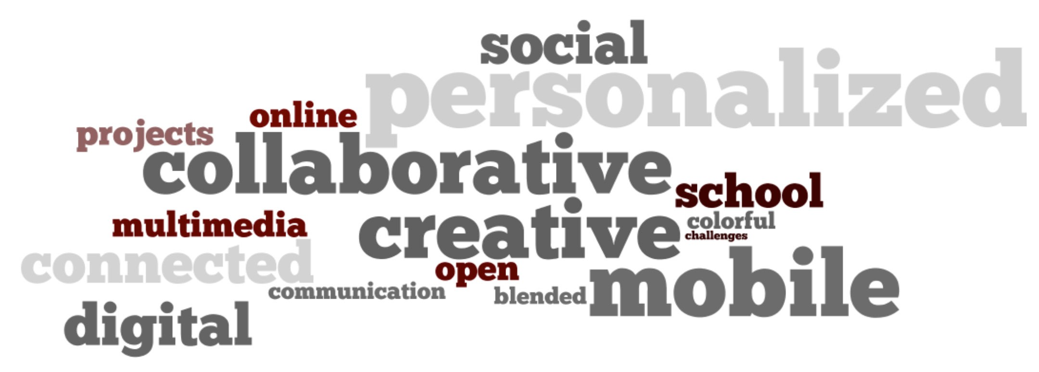
What should learning look like in the 21st century?

Slide 6
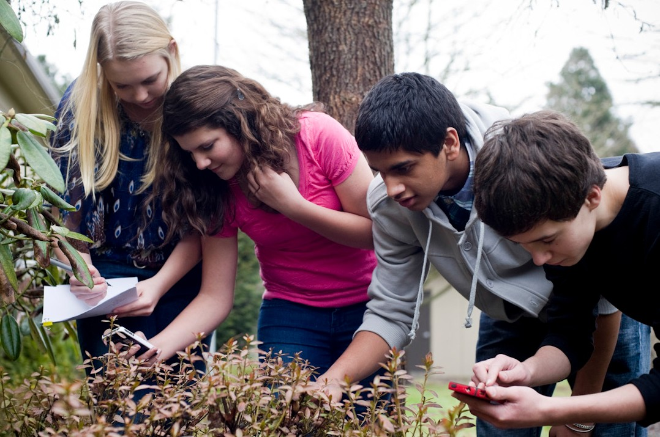
21st Century Learning is…
Mobile
Students live in a world with anytime, anywhere access to information at their fingertips.

Slide 7
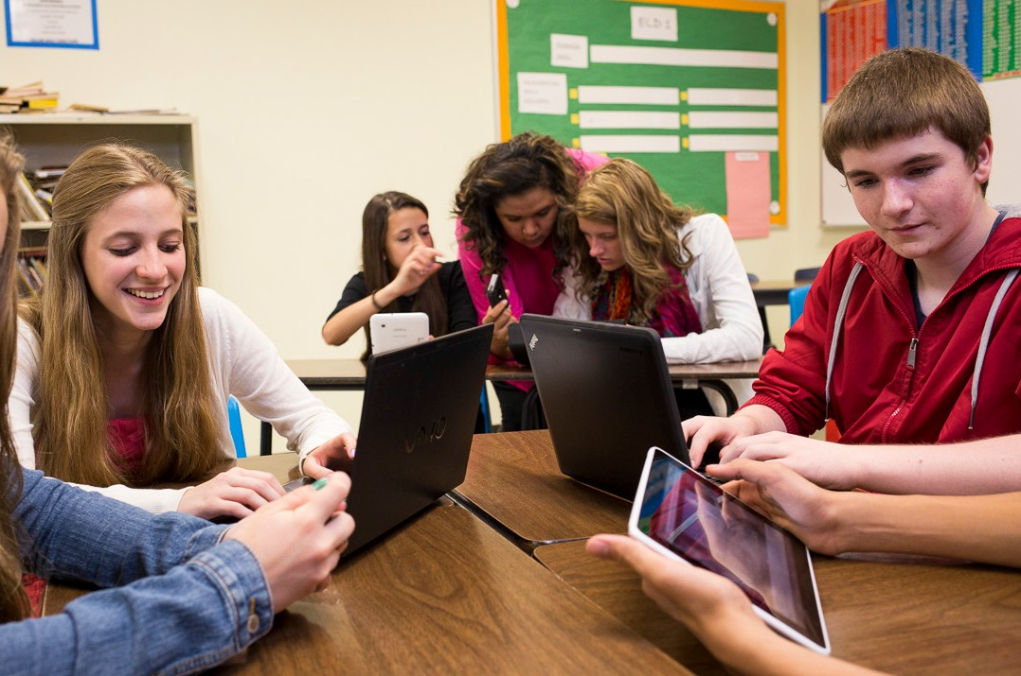
21st Century Learning is…
Collaborative
Technology has provided our students with a social, collaborative world. They thrive on teamwork and figuring things out with their friends.

Slide 8
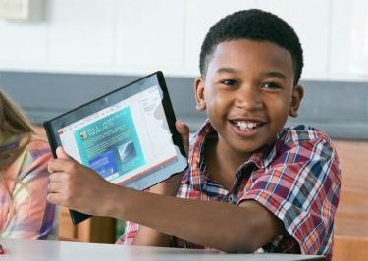
21st Century Learning is…
Connected
Today’s students want to connect with others in real time through social media and mobile devices.

Slide 9
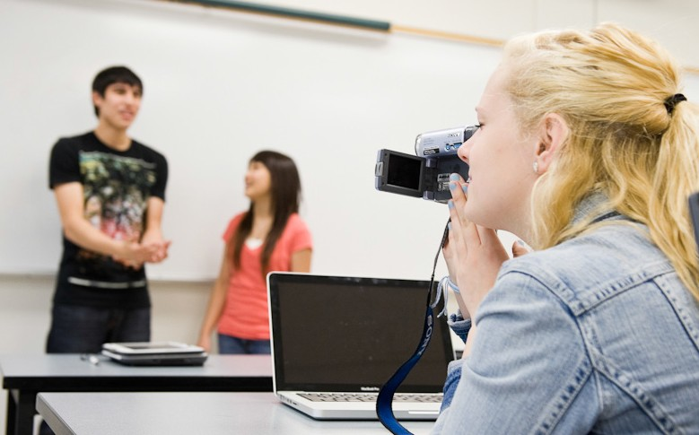
21st Century Learning is…
Multimedia
Today’s students are equal parts consumer and creator. They download and view audio and video, then create their own to upload and share with others. They are used
to having multimedia tools at their fingertips, and they are adept at using these tools to express their creativity.

Slide 10
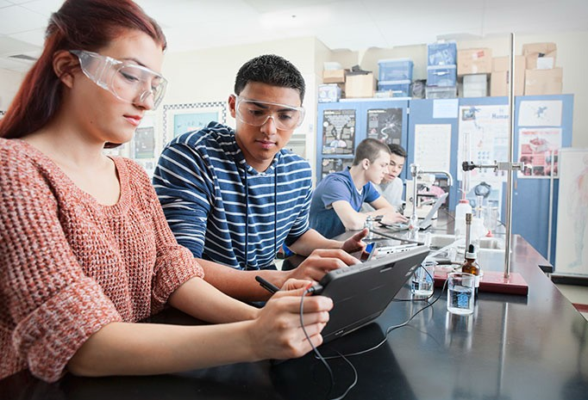
21st Century Learning is…
Constantly Changing
Constant change requires independent learners with new skills for changing work environments: critical thinking, collaboration, creativity, and communication.

Slide 11
21st Century Learning is…
New Skills and Literacies
Critical Thinking and Problem Solving
Collaboration across Networks and Leading by Influence
Agility and Adaptability
Initiative and Entrepreneurialism
Effective Oral and Written Communication
Accessing and Analyzing Information
Curiosity and Imagination

Slide 12

21st Century Learning is…
Physical and Virtual Learning Spaces
Students live in a world where they can learn anywhere, any time and from anyone.

Slide 13
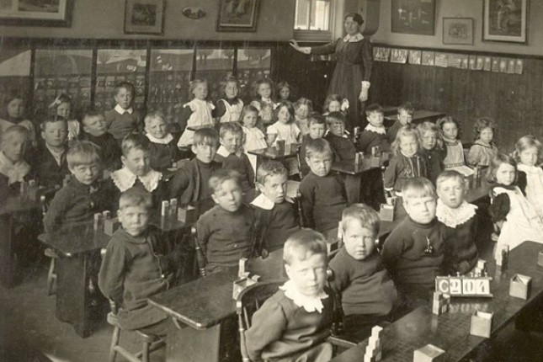
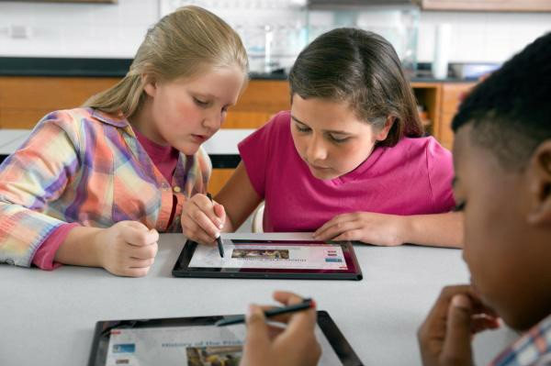
We have a clear vision of 21st century learning, but how do we get there?

Slide 14
Bring Your Own Device
PROS
Device for every student, anytime access
Parent-financed
Devices typically up-to-date
No cost for upgrades or repairs
CONS
Lack of uniformity of devices and platforms
Uncontrolled network access
Requires a robust network infrastructure with large bandwidth
Limitations of mobile devices

Slide 15
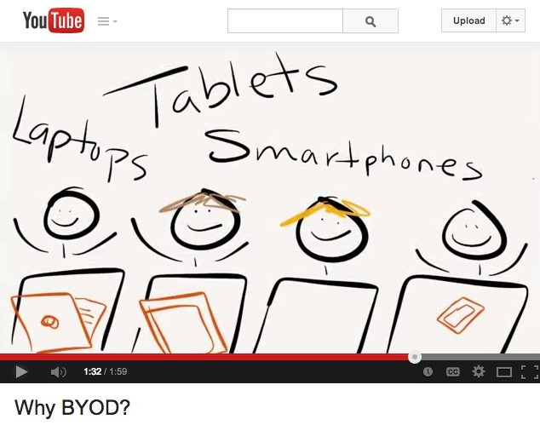
Comparing technology integration models
(Click to play video)

Slide 16
BYOD Benefits
Learning anytime, anywhere without schedule or access restrictions
Parent-financed, allowing schools to devote much-needed funding to other programs or technologies
Personalized devices
Devices are commonly more up- to-date with newer features
No repairs or maintenance
Cost-effective, works with decreasing technology budgets
Allows for immediate application in the classroom
Competitive pricing of tablets, smartphones, and laptop computers—BYOD a viable option for many families
Replicates a technology-rich environment already common in higher education and business
Flexibility—support different learners with different needs

Slide 17
BYOD Challenges and Considerations
Won’t my students be distracted by their devices? How am I ever going to compete for their attention?
Teachers have found success with simple signals, such as the words “Devices Down” when they need their students to stop and listen. When the devices are used as an integral part of the learning process, students won’t be distracted- they will be engaged
in using them to learn.
How will I prevent my students from accessing inappropriate sites on their devices?
Successful BYOD programs have strategies in place to help with classroom management of personal devices. A school AUP can establish and communicate specifically where and when devices can be used, as well as policies for social
networking and messaging.
How will I learn so many different devices?
You can rely on students to help one another- they are the technology experts.

Slide 18
BYOD Challenges and Considerations
The software that I use won’t work on cell phones or tablets. With so many different platforms and devices in one class, how will we collaborate and share files?
Web-based software applications work on most platforms and can accommodate common software needs, including photo editing and multimedia presentations, often
for free.
What about my students who can’t afford a device?
Without the cost of supplying a device for every student, schools can apply their technology budget to purchasing a set of devices for loaning. Some BYOD programs ask parents to donate used devices when they purchase new ones, or ask students to
share with one another.
Will BYOD cause more theft problems?
Most schools actually report a decrease in theft of devices.

Slide 19
BYOD Challenges and Considerations
I’m interested, but I don’t know how to start. It’s overwhelming to think about changing my entire teaching approach.
Successful BYOD programs build a network of support for teachers which may include professional development, in-class visits, and lesson demonstrations by instructional technology specialists. There are also BYOD professional communities online for help
and advice.
I’ve tried using online videos with my class in the computer lab. The videos streamed too slowly and the network kept crashing. If every student in the school has a device, it’s just going to slow down the network even more.
BYOD requires a school to upgrade its network infrastructure to handle the increased demands for bandwidth.

Slide 20
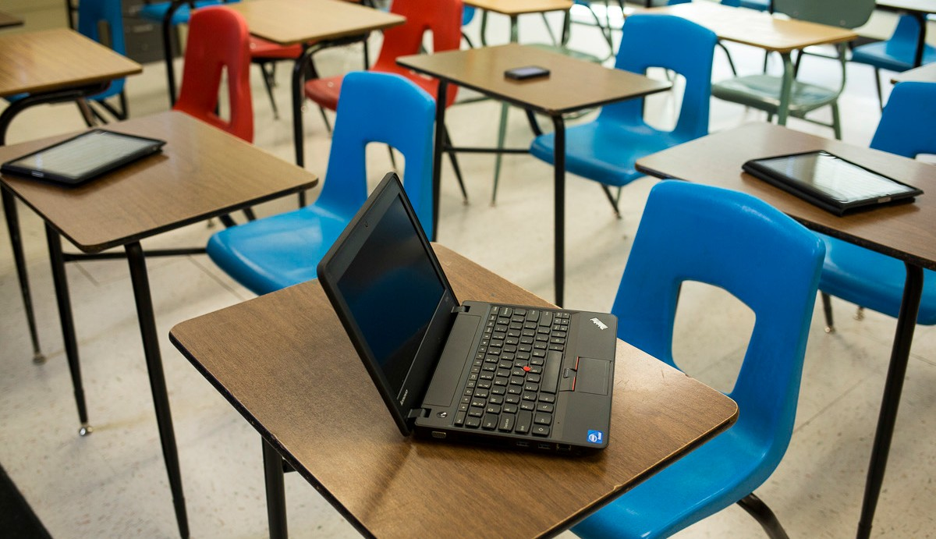
BYOD in the Classroom

Slide 21
BYOD in the Classroom
Data organization tools
Web-based applications for classroom polling and quick tests
Audio for podcasting and radio broadcasts
Video
QR codes
Digital storytelling
Language learning
Probe attachments for measuring data
Course companion sites

Slide 22

Meet Mike
Mike arrives at school with his cell phone
in his hand. Already he has connected with three of his friends and made plans to meet up at lunch time. During his first class, the teacher posts a question on the interactive whiteboard. Mike and the other students
respond to the question using their cell phones, then view the results in real-time on the board. This starts a class discussion, where Mike pulls his tablet computer out of his backpack to look up information that will support his opinion. At the height of discussion, the bell signals the end of class. The teacher promptly posts the question on the class website discussion forum. Mike reads and responds to his classmates’ continued discussion on his way to the next class.

Slide 23
Meet Mike
At lunch, Mike asks his friends for their opinions and adds their point of view to the discussion forum. Later that evening, Mike is at home listening to a podcast that he has downloaded. This inspires him to create his own podcast to present and
discuss his opinion on the topic. He uploads the podcast to the class website, where his peers promptly receive it on their own mobile devices. They leave comments on the site. The next day, the teacher uses these comments as material to launch
a new discussion. Mike eagerly pulls out his cell phone for another real-time poll.

Slide 24
BYOD encourages Mike to be:
Engaged in learning
Self-motivated
Self-directed
Independent
Creative
Collaborative
Communicative
A critical thinker

Slide 25
BYOD Educational Impact
More engaged and motivated students
Students are held accountable for their learning, puts them in charge
Encourages continued learning outside of the classroom walls
Personalized, students tap into their individual learning preferences
Helps students identify skills that will make them life-long learners
Gives students a preview of how their future workplaces will operate

Slide 26
This resource sponsored by Clarity Innovations
How will you inspire your students and engage them in 21st century learning?

