Slide 1
This resource sponsored by Intel Education
Education Client Procurement Guide
How to Select the Right Client Computing Platform for Your Needs

Slide 2

Objectives
This guide can help IT buyers in education make informed choices when:
Evaluating student, teacher, and administrator device platform computing performance, security, and management characteristics
Determining the importance of various technology and capability criteria
Considering factors that contribute to Total Cost of Ownership (TCO)
Drafting technical specifications

Slide 3
Education’s Evolving Computing Needs
Experience
Access Information from Any Device
Responsiveness
Easy Collaboration Between Students, Teachers, and Administrators
Ensure Anywhere/ Anytime Productivity
Consistent Performance
Intuitive to Use
Relevant Addition to Curriculum
Device
Mobile
All-Day Battery Life
Durable Enough for School Use
Touch-Enabled
Instant On
Always Connected and Up to Date
Suitable for Online Testing
Supports Collaboration
Promotes 21st Century Learning
IT Requirements
Low TCO
Compliance
Supports Easy Integration of Different Teaching and Learning Systems
Compatibility
Student Data Security
Device Security
Easy Manageability
Support Standards-Based, Personalized Learning Plans
Safely Collects Student- Level Data to Enable Analysis of Instructional Approaches

Slide 4
Key Considerations
User requirements. Do students, teachers, and support staff have the right tools to do their jobs—both today and over the next few years?
New capabilities. What are the latest computing features that could make a valuable difference to a school or district?
Total Cost of Ownership (TCO). What are the direct and indirect costs associated with acquisition, maintenance, and support?

Slide 5
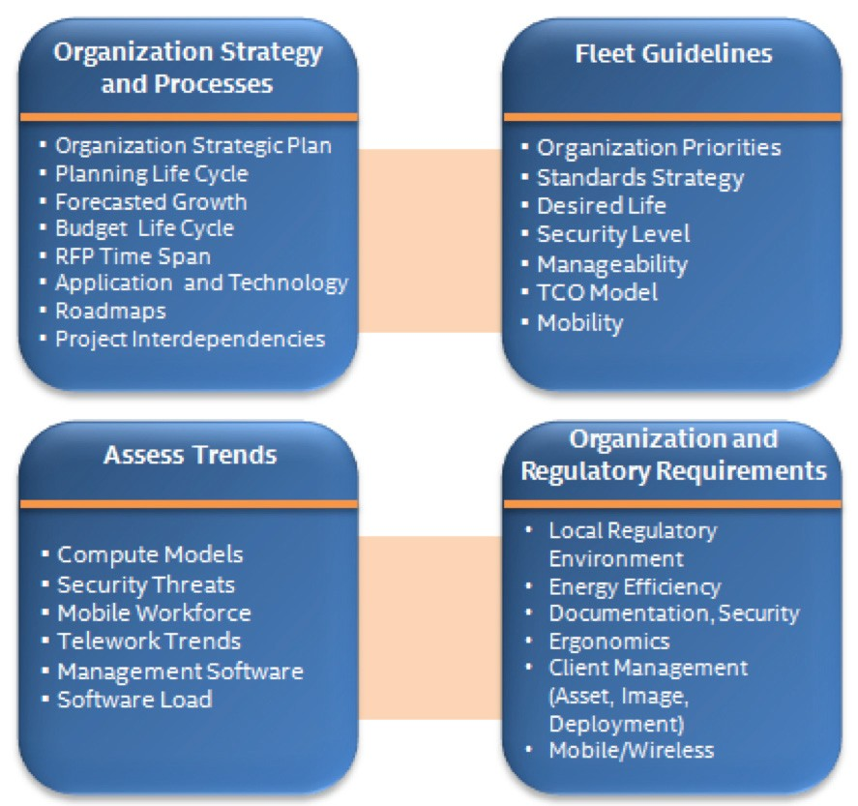
Intel’s Best Value for Money Procurement Model
Based on best practices used by Intel IT, this model highlights important planning elements that form part of Intel’s device procurement process including strategic planning, business analysis, and sourcing.

Slide 6
Strategy and Processes
Crucial to any strategic planning effort is an understanding of a school or district’s strategy and processes for IT procurement.
These typically include elements such as:
Strategic objectives
Budget lifecycle
Procurement processes
Program interdependencies

Slide 7
Assess Trends
To make smart choices, assess the potential impact of factors like:
Upcoming operating system or productivity software releases
Improved management solutions that can lower TCO
Evolving security threats and the need to support capabilities such as anywhere/anytime learning, collaboration tools, and online testing
New device models and form factors

Slide 8
Consider Organization and Regulatory Requirements
Education IT departments need to satisfy a variety of state and federal regulations as well as district requirements, which can include the need to:
Meet a certain level of energy efficiency in device purchases
Ensure classrooms and workspaces are safe and ergonomic
See that student data and information are properly secured and protected

Slide 9

Create User Profiles
Profile your main categories of device users:
Students
Teachers
Administrative staff
IT support staff
Computer lab users
Online test takers

Slide 10
Do a Current State Analysis
Take inventory of current IT assets
Assess current TCO
Break down the IT department’s overall operating costs
Assess the current support model including warranty terms and conditions, out-of-warranty repair costs, and service-level agreements

Slide 11
RFP and Procurement Execution
Purchase Plan
Configuration
Quantity Estimates
Purchase Schedule
Terms and Conditions
RFP
Develop RFP Scorecard and Document RFP Process
Solicit Supplier Participation
Map Responses to Requirements
Score RFP Responses
Procurement
Award Contract
Allocate Funds
Procure
Deploy

Slide 12
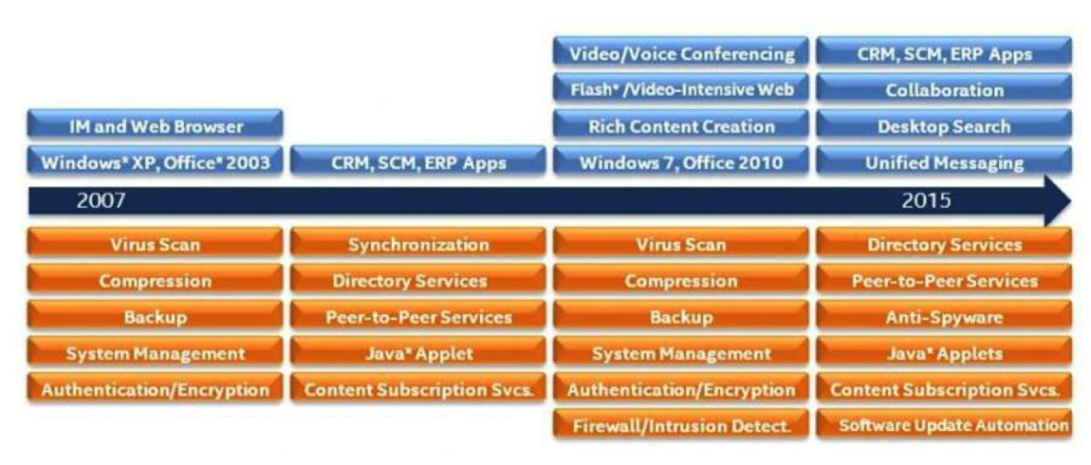
Plan Around Current Education Needs
Education Needs Have Changed
Increasing Workload: Background and Foreground

Slide 13
Security
A comprehensive solution is built upon three pillars:
Threat management
Identity and access
Monitoring, reporting, and remediation

Slide 14



Form Factors
Desktops For regular use at a single location, this
category includes tower, small-form-factor, and all-in-one designs.
Ideal for computer labs and intensive content creation (such as video and audio).
Laptops and Notebooks
For classroom or mobile use, these versatile, portable computers can accomplish most any task—from research to report writing to online testing.
Ultrabook™ These thin and light notebooks deliver maximum
responsiveness, long battery life, mobility and hardware-based security.

Slide 15

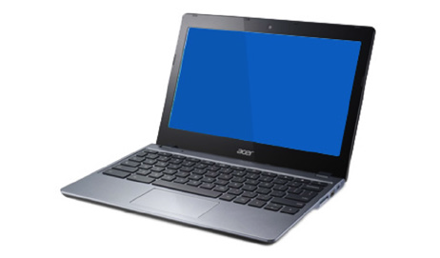

Form Factors
2 in 1
These versatile hybrids can function like a tablet when you want it or a laptop when you need it. Ideal for upper elementary grades that may use touch-based
education apps but also require the productivity options of a laptop.
Chromebook These thin, light and primarily cloud-based laptops feature school- friendly performance, long battery life, easy
manageability and automatically updated security.
Tablet
These ultra-mobile computers combine the display, circuitry, and battery into a single unit. Ideal for earlier grades utilizing education apps. Also useful for teacher presentations and real- time student feedback due to enhanced mobility.

