Slide 1


Making the Case for Computational Thinking in the Classroom

Slide 2

It is nearly impossible to find a modern occupation that does not, somehow, utilize technology
And, as innovations build atop innovations, it will be vital for the vast majority of industries to employ workers who can “communicate” with computer-supported solutions in some way.
Image: Shutterstock
Notes:
Source image: shutterstock_552315334.jpg

Slide 3
Computational thinking is the thought processes involved in formulating problems in a computer-like way
The power of computational thinking is in its potential to allow us to solve problems at a scale never before imagined. And today’s computational thinkers will be the developers of the technology that will define tomorrow.

Slide 4
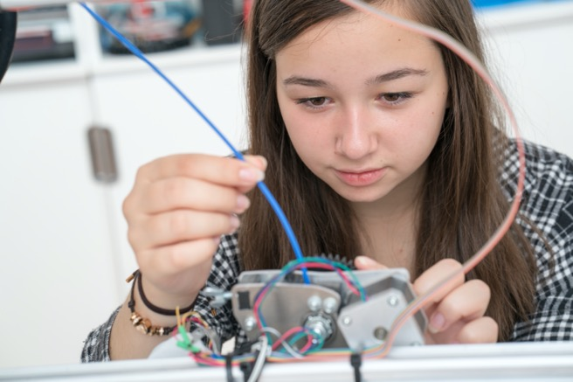
Every student has the capability of solving problems, extending their thinking, reinforcing higher-order thinking skills, and building tools utilizing computers
Students will utilize these skills to take on the grand challenges of the 21st century.
Image: Shutterstock
Notes:
Source image: shutterstock_526495273.jpg

Slide 5
Computational thinking helps learners to automate solutions that solve problems more efficiently
It doesn’t take the place of creativity and critical thinking but amplifies these qualities by better utilizing the full potential of technology to extend and expand problem-solving capacity while engaging higher-order thinking.

Slide 6

By integrating computational thinking practices into their teaching, teachers change the focus from teaching how to use technology to how to create technology
Students engage in computational thinking by using algorithms to solve problems, by analyzing text and large data sets, by constructing complex communications, and by identifying patterns while conducting scientific investigations.
Image: Shutterstock
Notes:
Source image: shutterstock_695764750.jpg

Slide 7
Shifting from a teacher-centered learning environment to a student-centered one
This helps to support a competency-based education where it is not just about what a students knows, but about what students do with what they know. This ensures that a student’s education is more in-line with future professional expectations.

Slide 8

Teachers must be shrewd and find ways to infuse computational thinking across all disciplines to provide students with the skills they need to solve current and future challenges
Image: Shutterstock
Notes:
Source image: shutterstock_695764816.jpg

Slide 9

Computational thinking skills are seldom delivered within a unified framework and vocabulary
If a teacher uses the term “abstraction” when showing students how to create formulas in various mathematics disciplines, then students will begin to see how the approach can be applied in everything from algebra to writing.
Image: Shutterstock
Notes:
Source image: shutterstock_124813243.jpg

Slide 10
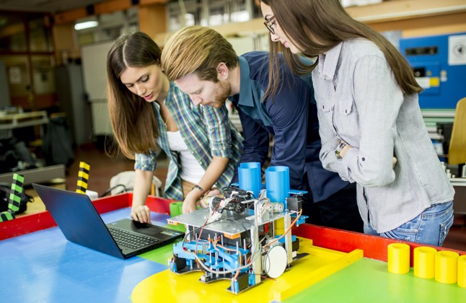
Computational thinking can be integrated across and embedded within a teacher’s curriculum without requiring the creation and implementation of an entirely new curriculum
The practice of computational thinking can also feed STEM, 21st century skills and even Common Core efforts.
Image: Shutterstock
Notes:
Source image: shutterstock_551854081.jpg

Slide 11
To help establish buy-in, parents need to realize that the future world inherited by our children will be full of new opportunities and challenges that we can’t even imagine
Computational thinking skills will help children to better prepare and ultimately succeed in an age even more reliant on technology. Much of what is taught today may be obsolete tomorrow. This is why it’s so important to teach the thought processes behind what is taught: empowering students to become lifelong learners so they can seize future opportunities, regardless of how the technology may change.

Slide 12
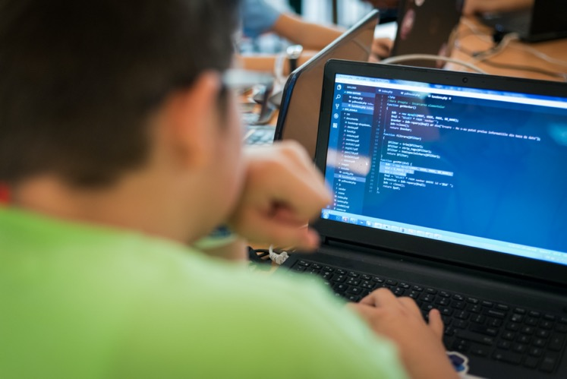
Ten Benefits of Computational Thinking
1) Students are better prepared for an increasingly technological world when they understand computational thinking concepts. It prepares students for their future by creating college- and career-ready students.
Image: Shutterstock
Notes:
Source image: shutterstock_735002869.jpg

Slide 13

Ten Benefits of Computational Thinking
2) It deftly blends academic concepts with real-world concerns and scenarios, providing a framework for learning connections.
Image: Shutterstock
Notes:
Source image: shutterstock_653915692.jpg

Slide 14

Ten Benefits of Computational Thinking
3) Prepares students for further STEM study while aligning with existing national standards.
Image: Shutterstock
Notes:
Source image: shutterstock_150780245.jpg

Slide 15

Ten Benefits of Computational Thinking
4) By boosting innovative thinking, students become more engaged: reducing dropout rates. It also helps to close the achievement gap by engaging minority students.
Image: Shutterstock
Notes:
Source image: shutterstock_157632053.jpg

Slide 16

Ten Benefits of Computational Thinking
5) Expands a student’s creative process and their ability to innovate: encouraging risk-taking and entrepreneurship.
Image: Shutterstock
Notes:
Source image: shutterstock_234048079.jpg

Slide 17

Ten Benefits of Computational Thinking
6) Helps students to think logically and creatively and raises the competitive bar for schools and communities: boosting achievement for all students, especially the traditionally marginalized.
Image: Shutterstock
Notes:
Source image: shutterstock_1313541308.jpg

Slide 18

Ten Benefits of Computational Thinking
7) Helps develop workers that can solve problems in real-time with creativity and diligence: ultimately creating innovative new products and services.
Image: Shutterstock
Notes:
Source image: shutterstock_760442419.jpg

Slide 19

Ten Benefits of Computational Thinking
8) Computational thinking is a key interdisciplinary component that—by building critical thinking and problem-solving skills—prepares students for global competitiveness while securing our country’s future cyberinfrastructure and communications.
Image: Shutterstock
Notes:
Source image: shutterstock_695764816.jpg

Slide 20

Ten Benefits of Computational Thinking
9) Increases a state’s competitive advantage as a well-prepared workforce translates to increased economic development.
Image: Shutterstock
Notes:
Source image: shutterstock_306872894.jpg

Slide 21

Ten Benefits of Computational Thinking
10) These concepts are already being taught in many lessons, and simply need to be reframed within computational thinking frameworks to be more impactful: saving money and professional development hours.
Image: Shutterstock
Notes:
Source image: shutterstock_554621557.jpg

Slide 22
Resources for Educators
10 Classroom-Ready Computational Thinking Resources for K-12, Getting Smart
Computational Thinking Teacher Resources, ISTE
Computational Thinking Across the Curriculum, Educause
Computational Thinking, Design Thinking and Innovation, Kathy Schrock
Computational Thinking Resources for Teaching, Computational Thinking Initiatives

