Slide 1
Personalized Learning

Slide 2
Workshop Goals
To learn the characteristics of personalized learning and how it compares and contrasts with other instructional approaches.
To understand what personalized learning looks like in the classroom.
To begin to develop a strategy for implementing personalized learning in schools.

Slide 3
Overview of Personalized Learning

Slide 4

What is Personalized Learning?
Differentiation
Hands-On Learning
Student-Centered Instruction
Personalized Learning
Active Learning
Project-Based Learning
Individualized Instruction
Inquiry Methods
Copyright © 2016 K-12 Blueprint.
*Other names and brands may be claimed as the property of others

Slide 5
Characteristics of a Personalized Learning Environment
Students work to meet standards
Students manage their own learning
Students collaborate with peers and adults.
Students use technology to meet learning goals.
Students are assessed in multiple ways.
Students make choices about what and how they learn

Slide 6
“The infiltration of a sweeping range of different technologies into our everyday lives has created an expectation that all interactions should be highly personalized to meet our individualistic needs. The evidence of these expectations is commonplace now and for many, no longer is it a ‘wonder of technology’ surprise” (p. 1).
Project Tomorrow, & Blackboard Inc. (2012b). Mapping a personalized learning journey: K–12 students and parents connect the dots with digital learning. Speak up 2011 national findings K–12 students & parents. Irvine, CA: Project Tomorrow.

Slide 7
Personalized Learning and Technology Integration
Students have access to online resources that enable them to make choices about content.
Mobile devices allow students to access resources and complete tasks any time and anywhere.
Online tools and apps expand the ways in which students can demonstrate their learning.
Working with technology prepares students for life and work in the 21st century.

Slide 8

“Students, perhaps without even realizing it, are already seeking out ways to personalize their learning. Looking to address what they perceive as deficiencies in classroom experiences, students are turning to online classes to study topics that pique their intellectual curiosity, to message and discussion boards to explore new ideas about their world, or to online collaboration tools to share their expertise with other students they don’t even know” (Project Tomorrow, p. 1).

Slide 9
Just the Facts about Personalized Learning
Fiction | Fact
Students decide what they want to learn. | All students meet standards but make choices in addition to and within those standards.
All students work individually on tasks designed for them. | Students work with small and large groups, as well as alone.
Students do not receive grades. | Students participate in a variety of formative and summative tasks, in addition to grades.
Students are free to take the easiest path to learning. | Self-directed learning and meeting challenges are important components of personalized learning.

Slide 10
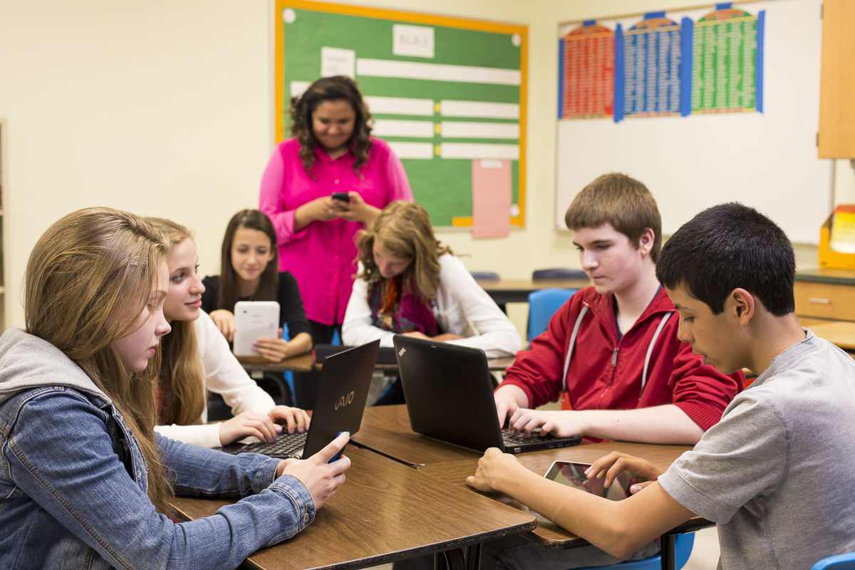
A Tale of Two Classrooms
Megan and Tyler are middle school students in earth science classes at two different schools studying tectonic plate theory.
Megan’s school takes a traditional approach to instruction.
Tyler’s school uses a 1 :1 computing model to personalize learning.
These are their stories…

Slide 11

Traditional Classroom
Megan completes the following activities in a traditional learning environment:
Reading from a textbook and completing end-of-chapter questions.
Listening to teacher lectures.
Watching videos on tectonic plates.
Participating in whole-class Q & A reviews.
Completing a study guide.
Taking a unit exam.

Slide 12
Traditional Classroom
Megan learns the following content knowledge and skills:
Facts about tectonic plates
How to read a textbook
How to find answers to fact-based questions
How to memorize information
How to study for and take tests
Managing time for studying and completing homework tasks.

Slide 13
Personalized Classroom
Tyler completes the following activities in a personalized learning environment:
Setting personal goals for content and 21st century skills.
Investigating tectonic plates with online searches.
Developing and answering a research question.
Working with a group to conduct research about a topic of interest related to tectonic plates.
Conferencing online with a geologist.
Developing a digital model to explain the research.
Presenting findings to peers and community members.

Slide 14
Personalized Classroom
Tyler learns the following content and skills:
How tectonic plate theory explains the world he lives in (Next Generation Science Standards).
Asking questions that can be answered with research (NGSS).
Developing a model to explain a natural system (NGSS).
Collecting, analyzing, and interpreting data (NGSS).
Project planning.
Metacognition, goal setting and reflection.
Time management.
Technology literacy.
Creativity.
Collaborating with peers and adults (NGSS).
Communicating a scientific argument(NGSS).

Slide 15
Benefits of Personalized Learning in a 1:1 Environment
Support for student-centered instruction
Student engagement and ownership
Development of 21st century skills such as collaboration and self-direction
Student interest in and proficiency with technology
Access to student data that can drive teaching and learning.

Slide 16
I. Your Turn: Reflect and Discuss Personalized Learning

Slide 17
Personalized Learning and Instruction

Slide 18
Personalized Learning and
Standards
Mathematics
  Focus on conceptual understanding of fewer topics encourages more in-depth study allowing for student choice.
  Standards on developing procedural knowledge and metacognition support goal-setting, self-knowledge, and self-direction.
  Emphasis on application of knowledge and skills to real-world problems promotes engagement and deep understanding.

Slide 19
Personalized Learning and
Standards
English Language Arts
  Close reading of different kinds of complex texts, specifically non-fiction, promotes student engagement and real world application.
  Emphasis on reading and writing skills and strategies rather than specific works of literature and types of writing supports student choice.

Slide 20
Personalized Learning and
Standards
Next Generation Science Standards
  Decreased emphasis on facts and vocabulary supports in-depth exploration of science concepts.
  Emphasis on connections among different areas of science creates a realistic view of scientific thinking.
  Application of scientific concepts to the real world encourages student engagement, critical thinking, and student choice.
  A focus on developing scientific arguments connects science to the real world.

Slide 21
Personalized Learning and
Standards
National Council of Social Studies Standards
  Decreased emphasis on names, dates, and events, and increased emphasis on themes and concepts allows students to pursue areas of interest.
  Common Core State Standards for literacy support the use of primary sources and communicating ideas.

Slide 22
Personalized Learning and
Standards
All new standards support personalized learning with the following emphases:
  Collaboration
  Creativity
  Critical thinking
  Application of knowledge to real world situations
  Formative assessment to guide instruction
  The use of technology to self-manage and solve problems

Slide 23
In the Classroom: Signs of the Times
CCSS for English Language Arts and Literacy in History:
Demonstrate knowledge of eighteenth-, nineteenth- and early-twentieth-century foundational works of American literature, including how two or more texts from the same period treat similar themes or topics.
Integrate and evaluate multiple sources of information presented in different media or formats (e.g., visually, quantitatively) as well as in words in order to address a question or solve a problem.
High school students study how literature is affected by the times in which it was created and the impact that fiction can have on society. Students
Choose a novel that highlights a social or political issue from the past
Examine primary sources from the time in which it was written.
Analyze the data to produce two digital products
  A commentary written by a contemporary of the author
  A modern discussion of the novel that takes into account its historical context.
Notes:
(such as Huckleberry Finn, Animal Farm, Uncle Tom's Cabin,, or Jane Eyre)

Slide 24
In the Classroom: Pedal Power
CCSS for Mathematics:
Understand and apply theorems about circles.
Similarity, right triangles, and trigonometry
Expressing geometric properties with equations
As a culminating activity to instruction in functions, linear equations, and proportional reasoning, algebra students explore the mathematics of bicycles. Students
Work in pairs to investigate one aspect of the bicycle.
Apply math formulas and data to explore in depth.
Use multimedia to share their learning.
Notes:
Using bicycle-related relationships-such as wheel diameter and coasting distance, or frame tubing size and weight allowances

Slide 25
In the Classroom: Biomes in Action
Next Generation Science Standards
HS- LS2 Ecosystems: Interactions, Energy, and Dynamics
HS-LS4 Biological Evolution: Unity and Diversity
HS-ESS3 Earth and Human Activity
Students take the role of environmentalists and work in groups to develop solutions to contemporary environmental problems. Students
Research the features of a specific biome.
Investigate the human impact and its harmful effects on the biome.
Analyze the problems
Develop scientific arguments to solve the problem of human encroachment.
Present their solutions in multimedia formats.

Slide 26
What is Personalized Learning?
Differentiation
Hands-On Learning
Student-Centered Instruction
Personalized Learning
Active Learning
Project-Based Learning
Individualized Instruction
Inquiry Methods

Slide 27
Defining Terms:
Critical for Personalized Learning
Term | Definition
Active Learning | Instructional approach that involves students in managing their own learning.
Student-Centered Instruction | Teaching methods that support personalized learning by focusing on students’ active involvement in learning.

Slide 28
Related to Personalized Learning but Not Necessary
Term | Definition
Project-Based Learning | Instructional methods where students engage in long-term investigations and products related to real world situations.
Inquiry Approach | An approach to teaching and learning where students are presented with or compose their own questions or problems and work with the help of teachers and others, to find answers.

Slide 29
Can Be Related to Personalized Learning
Term | Definition
Differentiation | Refers to helping all students meet the same teacher-centered objectives through individualized programs and grouping.
Individualized Instruction | An approach where students generally work alone through a set of tasks to meet a level of performance.
Hands-On Learning | Student activities in which students manipulate physical objects, often used to promote or clarify abstract concepts or processes.

Slide 30
In the Classroom: Differentiation, Individualization, and Personalization
Differentiation: In Pao’s regular science class, the teacher uses flexible grouping and places students in groups for instruction based on assessment data. Although she sometimes participates in whole class activities, Pao is still learning English and usually works with other special needs students.
Individualization: Students in Jaden’s math class are assessed to determine their skills and then assigned tasks designed specifically to meet their needs. Jaden works by himself on a computer, to achieve mastery of each skill.
Personalization: In Mercedes’ English class she is allowed to choose from a list of recommended books to demonstrate her mastery of CCSS. She often works in groups with students of all levels and is encouraged to manage her own learning and to let her creativity shine with digital products that show what she has learned.

Slide 31
Range of Personalized Learning
Traditional Classroom
Students work occasionally with partners or groups on short activities.
Sometimes students choose from a set of options (e.g., problems or readings).
Students use rubrics to self-assess their work.
Technology is used mostly for research.
Transitional Classroom
Students work on 1-2 group projects a year.
Students use different tools to assess their learning..
Students often use technology to communicate and collaborate as well as to demonstrate learning.
Personalized Classroom
Students frequently make choices about projects in a variety of contexts.
Students set goals for content and 21st century skills, monitor their progress, and reflect on their learning.
Technology is seamlessly integrated throughout instruction

Slide 32
In Classroom: Traditional Math Classroom
A math teacher begins a unit on statistics and probability with a video and a lecture to review content they should have learned in earlier grades. In small groups they play a Bingo game with simple statistics questions and problems to review.
As the unit progresses, each day begins with a review of the previous day’s homework. Students exchange papers and the teacher explains the correct answers. Then the teacher presents a new concept through explanation and demonstration and students are assigned the next day’s homework. Occasionally, students are allowed to use their phones or classroom computers to work together on the first few problems, but they must do the remaining problems on their own..
Students are required to keep a math journal where they discuss their learning and ask questions. The unit concludes with a unit test.

Slide 33
In the Classroom: Transitional History Classroom
U. S. history students study the constitutional convention by first watching a video and then taking notes on a teacher lecture. After reading a chapter from their textbook, they choose one of the following online primary sources to analyze:
  George Mason’s “Objections to the Constitution”
  George Washington’s diary
  James Madison’s article in Federalist No. X.
  The cartoon” Conflict in Ratification of the Constitution”
  Students meet in groups to share their summaries and analysis of the documents. Then they collaborate with a partner on an online paper discussing their ideas.
  The unit concludes with a unit exam on important people, dates, and events along with a short essay question reflecting on what they have learned.

Slide 34
In the Classroom: Personalized Science Classroom
To begin a unit on energy sources, a science teacher invites the owner of a solar energy company to speak to the asking the students to use the talk to generate questions they would like to research on energy options.
After a class discussion, using a rubric that defines the standards and expectations they are supposed to meet, students in small groups choose a relevant issue to investigate, such as a type of energy, a political point of view, or a device. To show their learning they will create a digital product of some kind.
In their groups, students set individual and group goals, create a project plan, monitor their progress, conduct research, and assess how they are doing. They share their projects to get feedback from peers and publish their work to the class Web site. To insure individual accountability, students also take a unit exam.

Slide 35
One Class’s Journey to Personalization
Traditional Classroom
Students read from biology textbook and take notes from lectures.
Students bring biology-related news articles of their choice for discussion.
Students take online quizzes and get immediate feedback.
Students review for tests in small groups with a quiz app.
Transitional Classroom
Students read from biology textbook, take notes from lectures, and choose from a set of recommended videos to watch outside of class.
End-of-year projects involve creating digital products on selected topics.
Students self-assess their self-direction skills each grading period.
Personalized Classroom
Students have choices about topics and resources and learn skills to think critically.
They create digital and analog products in groups that emphasize creativity and collaboration.
Students set goals for biology and 21st century skills and monitor their progress.

Slide 36
Small Steps to Personalization
Giving students choices for short supplemental readings (e.g., chapter sections, news articles, poems, and short stories).
Provide options for end-of-unit activities (e.g., research papers, presentations, videos, and computer games)
Ask students to use rubrics to self- and peer assess complex projects.
Encourage metacognition and self-assessment with goal setting and reflection on content and 21st century skills.

Slide 37
Meeting the Needs of All Learners
Promoting student choice and real world application engages and motivates all learners but especially those who are reluctant or struggling.
Providing instruction in self-management skills is especially productive with struggling learners.
Offering opportunities for extended study meets the needs of students with advanced skills and interests.
By providing choices and using technolog,y English Language Learners can access materials in their native language so their content learning progresses while they learn English.

Slide 38
II. Your Turn: Reflect and Discuss Personalized Learning in Your School

Slide 39
Overview of Personalized Learning Activities

Slide 40

Components of Personalized Learning Activities
Student choice.
Student ownership
21st century skills
Technology integration

Slide 41
Student Choice in a Personalized Learning Environment
Choices about content and activities to meet standards.
Choices about specific topics to be pursued in depth.
Access to online tutorials, videos, and mobile apps to fill in gaps, reinforce learning, and acquire advanced skills and understanding.

Slide 42

Student Ownership in a Personalized Learning Environment
Goal-setting
Reflection
Metacognition
Self-management
Accountability

Slide 43
21st Century Skills in a Personalized Learning Environment
Creativity and innovation
Critical thinking and problem solving
Communication and collaboration

Slide 44
Technology in a Personalized Learning Environment
Information literacy
Media literacy
Digital citizenship
Technology operations and concepts

Slide 45
Effective Technology Integration
Technology is integrated into core curriculum weekly or more frequently.
Online formative assessments are done at least weekly.
Students use technology daily for online collaboration.
Students use search engines daily (Project Red, 2010).

Slide 46
In the Classroom: Ancient Civilizations
Emma, a high school sophomore is working on a project on ancient civilizations for her world history class. Because she is interested in international relations and is also taking Spanish, she received approval from her Spanish teacher to use her world history project on the Mayan people for both classes.
Emma has to show which content standards she will be meeting in both classes with this project. Her world history teacher also requires all students to target 21st-century skills with each of their projects, and for this project, he has asked all students to focus on goals related to creativity. Within the general category of creativity, Emma has written three goals, based on her own self-assessment and a conference with her teacher. Because of her interest in international relations, her teacher encouraged her to set a more advanced goal related to ancient civilizations.

Slide 47
Emma’s Goals
World History and Spanish Standards
Understand the rise of centers of civilization in Mesoamerica and Andean South America in the first millennium CE
Gain knowledge and understanding of other cultures.
Communicate in Spanish.
Personalized Goals
Be more creative by increasing the number of ideas I think of before I decide on what kind of project I want to do. And getting more feedback from my classmates and teacher on the value of my ideas before I decide.
Compare the relationship between the Mayans and other indigenous people of the Americas with the dominant cultures and relate these historical insights to current international relations issues within the Americas and between North America and Latin America.

Slide 48
III. Your Turn: Apply Personalized Learning Strategies to a Learning Activity

Slide 49
Preparing Teachers and Students for Personalized Learning

Slide 50
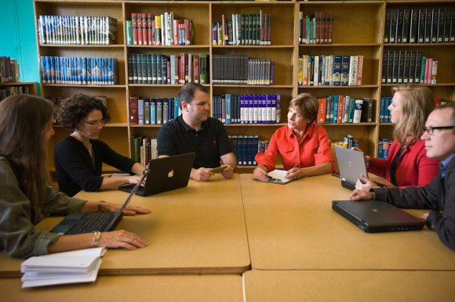
Teachers and Personalized Learning: Leadership
Create an atmosphere that inspires innovation.
Foster collaboration.
Be open to new ideas.
Be a connected learner yourself.
Locate and provide resources.
Take risks.
Have a visionary focus (Denski, 2012; Personalized Learning, p. 82).

Slide 51
Teachers and Personalized Learning: Professional Development
Create and support learning communities.
Provide high quality resources.
Use a variety of data to plan and assess experiences.
Incorporate learning theories for adults and students.
Align PD with educator and student performance.
Focus on small steps and risk taking.
Model best practices with technology (p. 131-2).

Slide 52
Students and Personalized Learning: 21st Century Learning Environments
Are structured and organized
Emphasize individual accountability
Support risk-taking and learning from failure
Encourage collaboration
Connect learners with each other and the real world

Slide 53

Students and Personalized Learning: Partnership for 21st Century Learning
Learning and Innovation
  Creativity and innovation
  Critical thinking and problem solving
  Communication and collaboration

Slide 54

Students and Personalized Learning: Partnership for 21st Century Learning
Information, Media, and Technology Skills
  Information literacy
  Media literacy
  ICT literacy

Slide 55
Students and Personalized Learning: Partnership for 21st Century Learning
Life and Career Skills
  Flexibility and adaptability
  Initiative and self-direction
  Social and cross-cultural skills
  Productivity and accountability
  Leadership and responsibility

Slide 56
Students and Personalized Learning: 21st Century Skills Instruction
Identification of specific rather than general skills
  Active listening, not collaboration
  Using a calendar app, not time management
Presentation and discussion of importance of skill
Modeling of skill in different contexts at different times throughout the year
Assessment of skill by students and teacher

Slide 57
Assessment and Personalized Learning
Educators want to know which curriculum works, which instructional techniques are most effective, and which lessons get through to students…. Personalized learning allows for testing that boasts richer and more relevant questions, more efficient scoring capabilities, improved test security, greater equity via electronic accommodations, results that let students know whether they are on track, and opportunities to personalize instruction, based on detailed, timely feedback (Bailey, Schneider, & Vander Ark, 2012; Personalized Learning, pp. 73-74).

Slide 58
Assessment and Personalized Learning: Standardized Assessment
“Standardized testing is only a measure of a point in time in a specific category of material on a test—not an accurate measure of students’ actual achievement or level of knowledge gained. A more personalized, differentiated approach to assessing students’ performances provides a holistic assessment of students’ full cognitive achievements and abilities” (Alberta Education, 2012; Personalized Learning, p. 73).

Slide 59
Assessment and Personalized Learning: Formative Assessment
“’There is a body of firm evidence that formative assessment is an essential component of classroom work and that its development can raise standards of achievement’” (Black & Wiliam, 1998; Personalized Learning, p. 75).

Slide 60
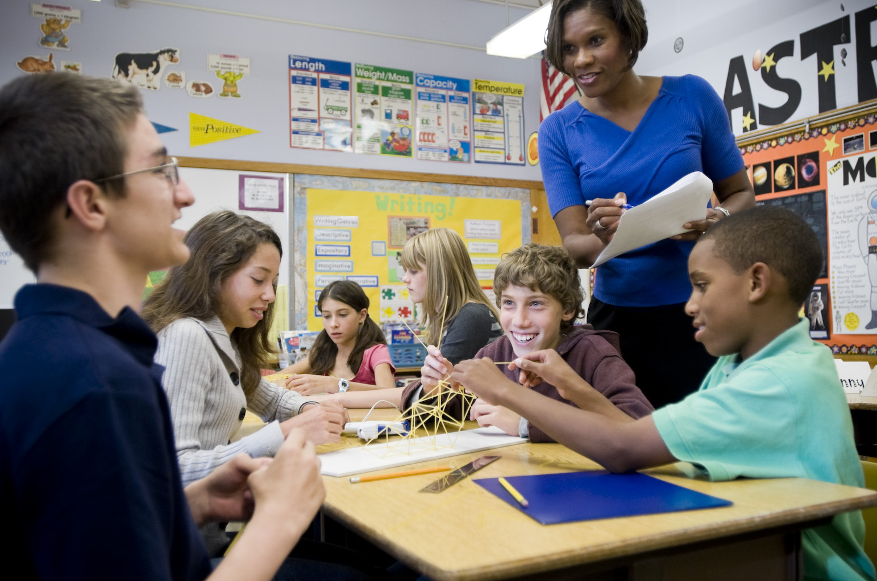
Formative Assessment: Purposes
Gauging student needs
Developing 21st Century Skills
Monitoring student progress
Checking for understanding

Slide 61
Formative Assessment: Strategies
Self- and peer assessment
Rubrics
Checklists
Project plans
Observation
Conferences
Informal questioning
Quizzes and surveys
Portfolios

Slide 62
In the Classroom: Assessment in a Personalized Learning Environment
Turning Points in History
In a world history class student groups select the three most important turning points in European history from 1500 to 1939. They use historical research and reasoning to form their arguments and participate in a mock debate defending their choices.
Assessment
The teacher questions students formally and informally throughout the unit to determine their understanding of content.
Students use an argumentation rubric to self- and peer assess their reasoning.
The teacher assesses information literacy, collaboration, and critical thinking through observation throughout the project.
Students reflect on their learning and take a final unit essay exam.

Slide 63
IV. Your Turn: Highlight Assessment in Your Personalized Learning Activity

Slide 64
Challenges, Solutions, and Next Steps toward Personalized Learning

Slide 65

Challenges to Personalized Learning
Technology challenges
Instructional challenges
Student challenges
Parent challenges

Slide 66

Technology Challenges to Personalized Learning
Adequate infrastructure
Security and safety
Digital citizenship
School policies

Slide 67
Instructional Challenges to Personalized Learning
Teacher attitudes and feelings about technology
  Beliefs about teaching and learning
Worries about “covering” material
Concerns over classroom management in a personalized environment
Ties to “successful” teaching practices and topics
Fear of failure in a risk-averse environment

Slide 68
SAMR Model of Technology Integration
Substitution: Technology is used for tasks traditionally completed on paper, such as taking notes, taking tests, or writing a report.
Benefits
Teachers and students learn basic technology skills.
Teachers can “dip a toe” into personalized learning and can build confidence to move forward.
Drawbacks
Learning is not more personalized (although a technology-free class can be personalized to a degree).
Technology is not seamlessly integrated into the learning cycle.

Slide 69
SAMR Model of Technology Integration
Augmentation: Technology is used for traditional tasks but with added benefits due to technology, such as getting immediate feedback on a quiz or choosing a video to watch on a mobile device instead of in the classroom.
Benefits
Teachers may use technology to give students some choice about what and how they learn.
Teachers and students continue to develop technology skills and build confidence.
They may begin to experiment with other uses of technology for learning.
Drawbacks
Beliefs about teaching and learning as a teacher-centered activity may not change.
Students do not learn self-direction or other 21st century skills.
Assessment practices may not change to include more formative methods.

Slide 70
SAMR Model of Technology Integration
Modification: Technology is used to significantly re-imagine learning activities. Students are encouraged to create digital products to show their learning or to collaborate with peers and adults in and out of the classroom.
Benefits
Students complete projects that could not be done without technology.
They develop information literacy and technology skills valuable for the future.
They use technology to create, communicate, and collaborate.
Drawbacks
Students still may not be given much choice or control over what they learn.
The emphasis may be only on technology and not on other important 21st century skills.

Slide 71
SAMR Model of Technology Integration
Redefinition: Students create products that would not be possible without technology.
Benefits
Students learn content knowledge and skills by making choices, planning, monitoring their progress, and assessing the quality of their work
Drawbacks
Teachers may be unprepared to deal with a personalized learning environment.
Students may not have the skills to manage their own learning.

Slide 72
Student Challenges to Personalized Learning
Historical lack of engagement in academics
Lack of 21st century skills, especially self-direction
Beliefs about teaching and learning
Learning environments that avoid risk-taking
Concern about grades

Slide 73
Parent Challenges to Personalized Learning
Long-held beliefs about effective teaching and learning
Insecurity and lack of knowledge about academic content
Lack of proficiency and/or access to technology
Concerns about grades and standardized test performance

Slide 74
Possible Solutions to Challenges to Personalized Learning
“Small step” approach to professional development for teachers and staff with extensive support for risk-taking and learning from failure
Thorough consideration of technology needs
Thoughtful implementation of personalized learning approaches
Frequent explanations and reminders of reasons for and benefits of personalized learning
Supporting resources for students and parents

Slide 75
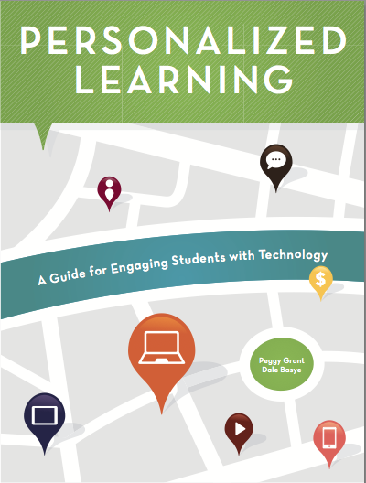
Personalized Learning: A Guide to Engaging Students with Technology

Slide 76
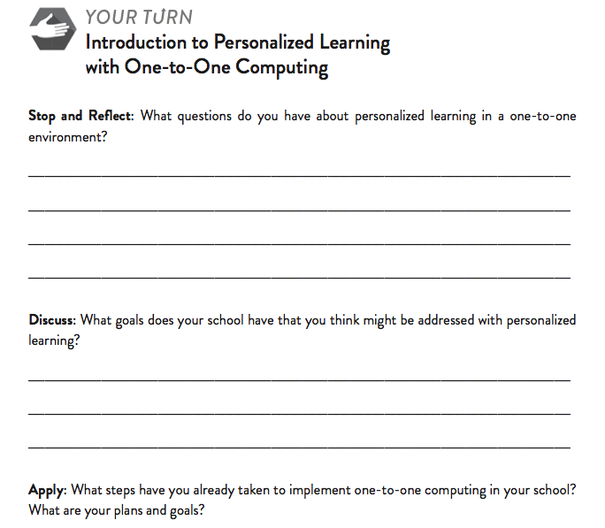
Personalized Learning Related Resources
Your Turn Activities
Reflection prompts, discussion questions, and application activities are included in Personalized Learning.

Slide 77
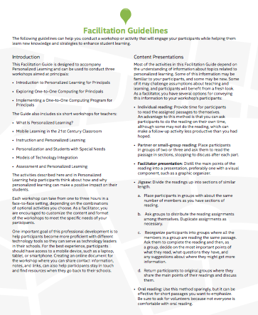
Personalized Learning Related Resources
Facilitation Guide
Additional resources for facilitators of activities related to Personalized Learning. The guide is available form the K12 Blueprint site.

Slide 78
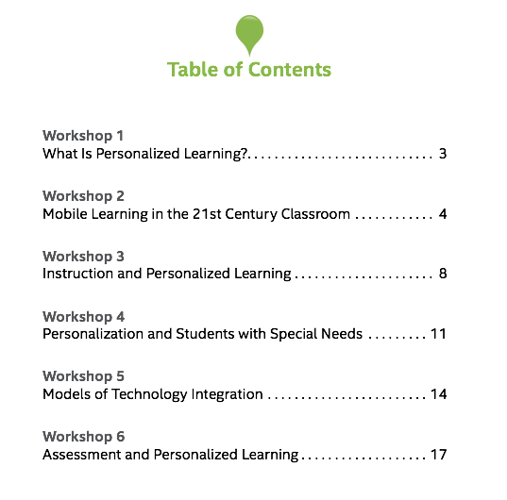
Personalized Learning Related Resources
Teacher Handbook
Resource for facilitators using Personalized Learning with teachers. Available from K12 Blueprint site.

Slide 79

Learn more at www.k12blueprint.com
Copyright © 2016 K-12 Blueprint.
*Other names and brands may be claimed as the property of others
www.k12blueprint.com

Slide 80
V. Your Turn: Next Steps Discussion

