Slide 1

This resource sponsored by Clarity Innovations
Technology Policy for Parents

Slide 2
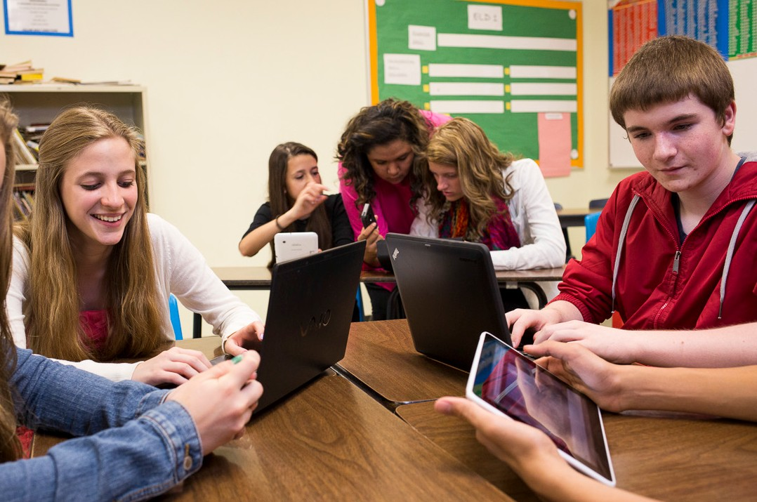
Know your school’s technology policies?

Slide 3
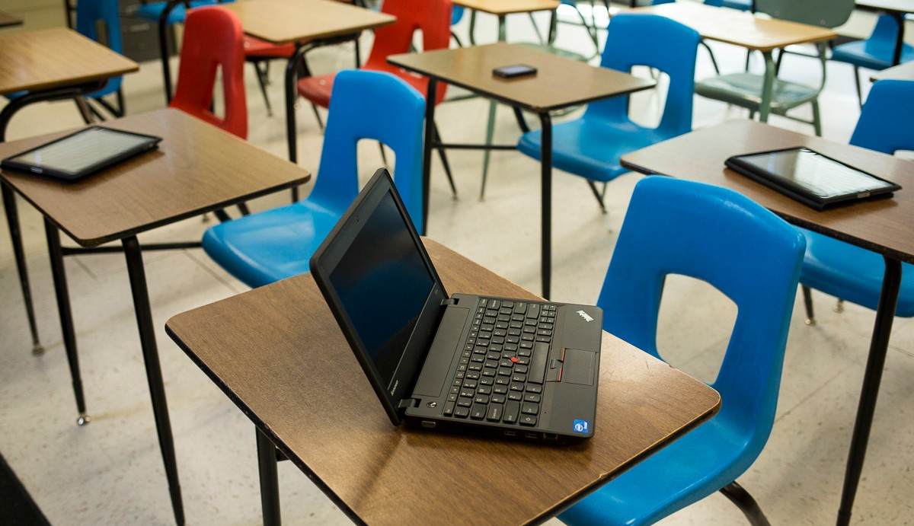
What type of technology integration has your school adopted and why?
1:1 Computing
Computer Labs
BYOD

Slide 4
Does your school have a 1:1 program?
Do all grade levels participate? If not, what are the reasons for the decisions about participation?
What kinds of technology do students have?
Can students take the devices home?
How are devices repaired, maintained, or replaced?
What are the policies regarding damage and loss of devices?
What kind of training do students receive on how to use the devices?

Slide 5
Does your school primarily use computer labs?
Are the labs mobile or fixed?
How many computers are in the lab? Do students share computers or do all students have their own device?
How often are the labs available for student use? Can they be used by individual students outside of regular class time?
What kind of supervision does the lab provide? Is there a technology expert available to support students?

Slide 6
Does your school have a Bring Your Own Device (BYOD) program?
Why was a BYOD policy adopted?
What kinds of devices are approved?
How will the devices be used?
What are the rules regarding the use of personal portable devices? What are the consequences for violations?
How is equal access for all students ensured?
What are school policies regarding the loss or damage to personal devices?
What parent permissions, if any, are required for participation?

Slide 7
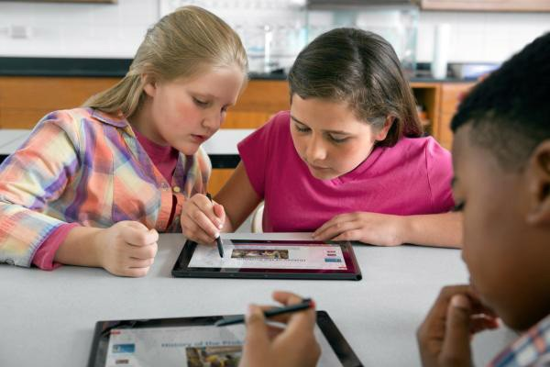
How do students take advantage of technology and stay safe when they are online?

Slide 8
How does technology enhance learning?
Are all technology policies designed to promote student learning?
Do policies support the use of portable devices and other tools, such as social media, in ways that expand learning opportunities and engage students?
Does online filtering improve students’ educational experiences?
Do teachers receive adequate professional development for seamlessly integrating technology into instruction.

Slide 9
How do students stay safe while online?
Are technology policies flexible enough to address both known security issues and as yet unknown problems?
Does the curriculum include robust instruction in technology literacy to teach students how to behave ethically and safely online, both in and out of school?

Slide 10

How open is the technology policy process?

Slide 11
Resources
Bring Your Own Device: Individual Liable User Policy Considerations. Good Technology.
Brush Up Your AUP. Technology and Learning.
Moving From ‘Acceptable’ to ‘Responsible’ Use in a Web 2.0 World Education Week
National Education Technology Plan. U. S. Department of Education.
A New Approach to Technology Policies. California School Boards Association.
Project Red.

Slide 12
Resources
The Digital Learning Revolution. RUSD Educational Technology.
School Technology Policies Are More Important Than Ever In The iPad-Enabled Classroom. Cult of Mac.
Schools can’t stop wondering what students do on Facebook. Arstechnica.
Technology Leadership Network. National School Boards Association.

